Slide 1
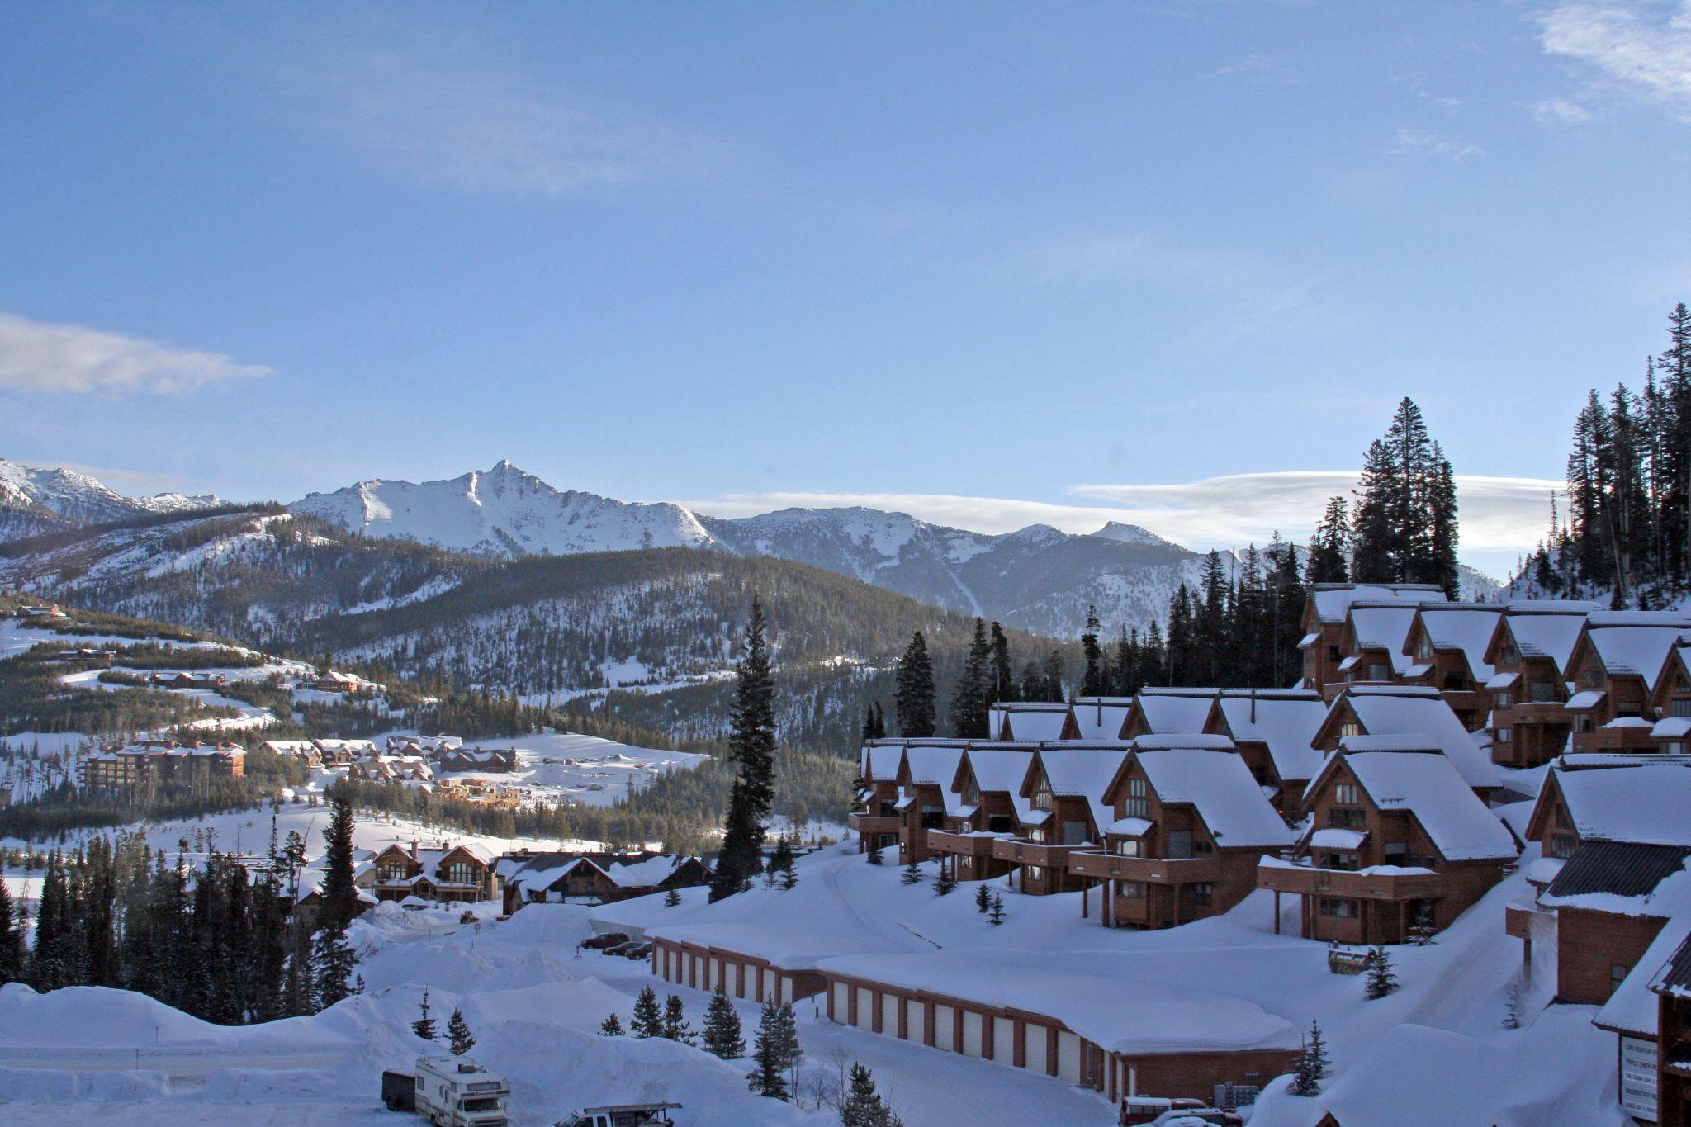
Big Mountain Executive Presentation

Slide 2
The Business Challenge
Market Comparison & Missed Potential
Recommendation Key Findings
Predictive Price Modeling
Revenue Impact Scenarios
Visual Benchmark: Big Mountain vs. Market
Cost-Benefit Summary
Summary

Slide 3
The Business Challenge
Problem Identification
Underpricing at Big Mountain Resort
Current adult weekend ticket price: $74
Market comparison and model analysis suggest this is significantly underpriced
Objective: Evaluate if a price increase is supported by infrastructure and market data

Slide 4
Market Comparison & Missed Potential
Market Context
How Big Mountain Compares to Competitors
Strong infrastructure: high vertical drop, large terrain, many lifts
Resort features are above average, yet priced below average
This mismatch may signal a **revenue opportunity**

Slide 5
Recommendation Key Findings
Recommendation & Key Findings
Raise weekend ticket price from $74 to $100–$105
This reflects fair market value based on predictive modeling
Introduce tiered pricing to capture more value and test customer response
Invest in snowmaking and chairlift capacity for future price flexibility

Slide 6
Predictive Price Modeling
Modeling Results
Machine Learning Model: Random Forest Regressor
Trained on U.S. ski resort data
Predicts fair market price based on features like terrain, lifts, and snowmaking
Predicted ticket price for Big Mountain: $100–$105

Slide 7
Revenue Impact Scenarios
Scenario Modeling
Scenario 2: Add 1 run, 150 ft vertical drop, 1 chair
Predicted price increase: ~$4.30
Revenue gain (5 tickets per visitor): ~$21
Scenario 3: Add 4 acres of snowmaking
Additional increase: ~$1.30
Combined gain: ~$27 per visitor

Slide 8
Visual Benchmark: Big Mountain vs. Market
Infrastructure vs. Ticket Price
Big Mountain offers above-average terrain, lifts, and snowmaking
However, it charges well below the market average for similar resorts
The chart on this slide shows Big Mountain’s position compared to the distribution of peer resorts
A red vertical line highlights Big Mountain in the histogram of ticket prices and infrastructure metrics
This visual makes the case for increasing the price to match value delivered

Slide 9
Cost-Benefit Summary
Cost Consideration
New chairlift cost per ticket: ~$2 (assuming 5-day visitors)
Scenario 2 revenue gain per ticket: ~$4.30
Net gain > 100% ROI just from chairlift alone

Slide 10
Summary
Big Mountain is underpricing despite strong infrastructure
Market and model support price of $100–$105
Recommend: Raise prices + test tiered model
Prioritize high-ROI investments (e.g., snowmaking, lifts)
Opportunity for sustainable revenue growth with minimal risk

